Slide 1
Understanding Animal Movements Through Agent-Based Modeling
Judy Mak
M.S. Candidate, Geography
San Diego State University

Slide 2
Research Questions
What drives the seasonal movements of animal species within a defined habitat, particularly endemic animal species?
Which factors, whether natural (elevation, vegetation type) or anthropogenic (tourism, resource use), are the strongest in determining this?
If animals share this habitat with humans, how might structural or demographic changes (emigration, etc.) influence the habitat over time?

Slide 3
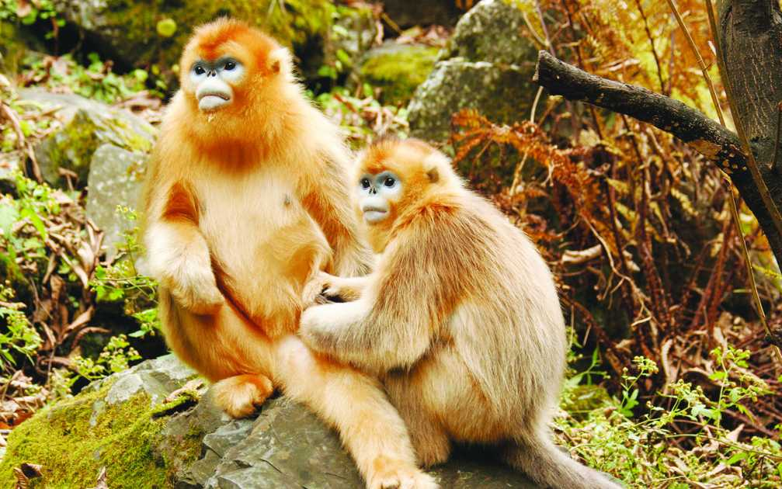
Objectives
To explore the degree to and manner in which human activity impacts the seasonal movements of animals in shared habitats
To build an agent-based model to better explain the factors influencing habitat change and/or animal movements within a habitat
Case study: Grey snub-nosed monkey (“golden monkey”)
and several other species in the FNNR

Slide 4
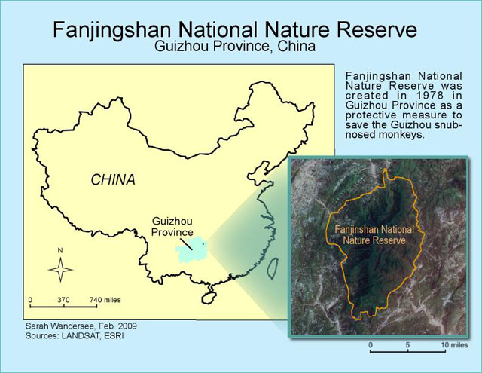
Study Site
(Wandersee 2009)

Slide 5
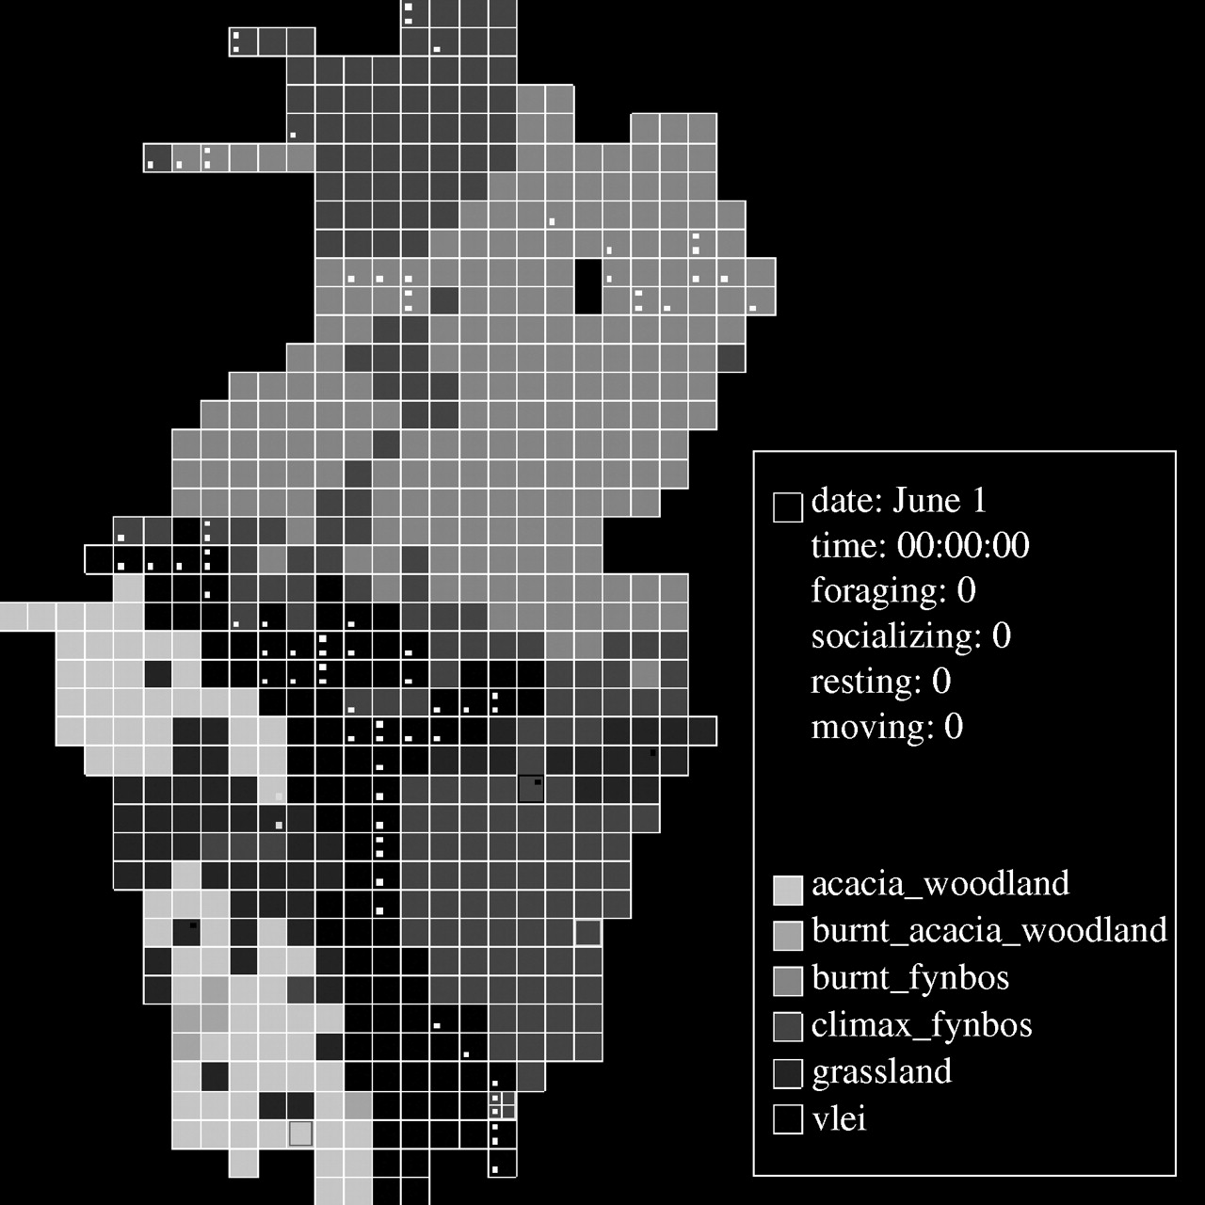
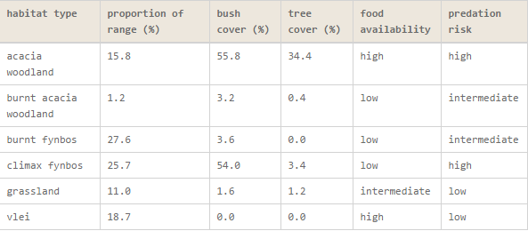
Literature Review
Past studies have shown potential in ABMs in tracking primate group decisions or in predicting primate population dynamics
Sellers et al. 2007, Robbins and Robbins 2004

Slide 6

Literature Review
“An agent-based model of group decision making in baboons.”
Sellers et al. 2007

Slide 7
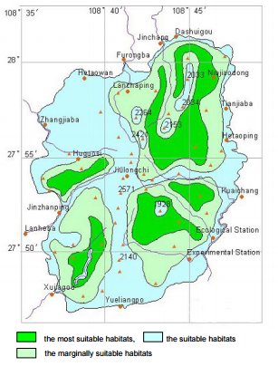
Literature Review
Much is known about the typical behavior of the Guizhou snub-nosed monkey (“golden monkey”)
Diet changes with season (Xiang et al. 2012)
Prefers elevations of 1500-1700m (Wu et al. 2004)
Habitat suitability for golden
monkeys within FNNR
From Wu et al. 2004

Slide 8
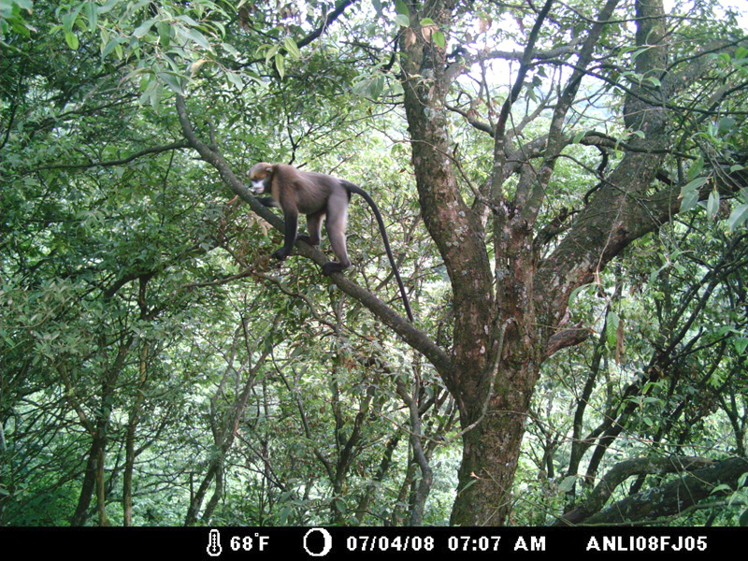
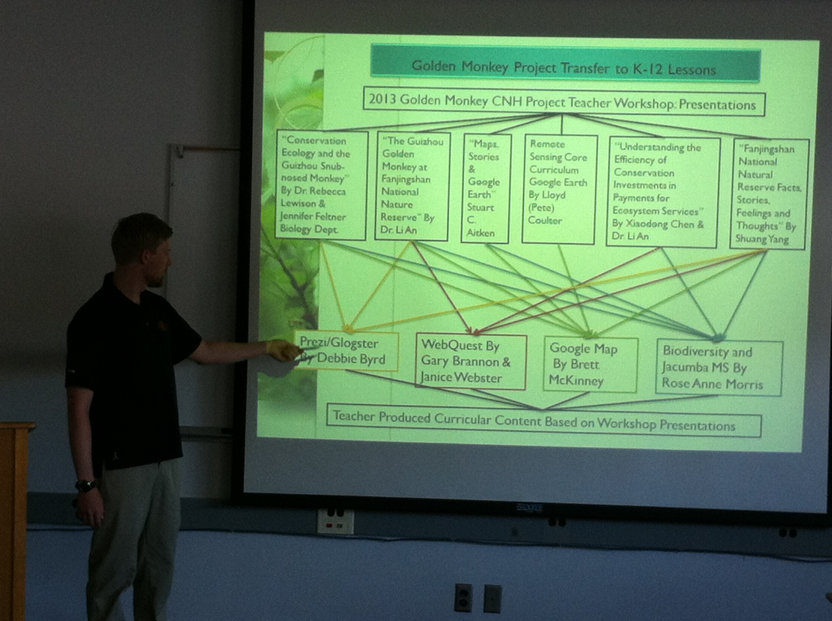
Literature Review
Past studies at SDSU of surveyed human attitudes/potential impact on the habitat of the grey snub-nosed monkey at FNNR
Golden Monkey project (Aitken et al. 2014, Aitken & An 2012, Wandersee et al. 2011, Tsai et al. 2011)

Slide 9
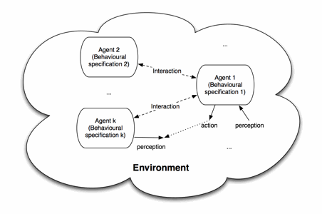
Hypotheses
Seasonal changes in human activity (e.g. increased fuelwood harvest in the winter) will correlate with animal movement farther away from human settlements
Even when given other factors such as seasonal vegetation change
Agent-based models can
be used to reliably track
the seasonal movements
of an endemic species within
a habitat

Slide 10
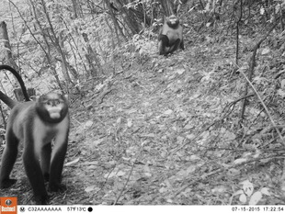
Existing Data: Camera Trapping
Automated cameras installed on-site to track sightings
Long-term camera-trapping data of various identified animal species in Excel format
Data collected 4/19/15 - 8/15/16

Slide 11
Existing Data: Camera Trapping
Asian Black Bear 0.1%
Domestic cat 0.1%
Crab-eating Mongoose 0.1%
Siberian Weasel 0.3%
Chinese Serow 0.3%
Chinese Ferret Badger 0.3%
Golden Monkey 0.4%
Koklass Pheasant 0.4%
Spotted Linsang 0.5%
Domestic Dog 0.5%
Leopard 0.5%
Flying Squirrel 0.7%
Masked Palm Civet 1.2%
Goat 1.2%
Malayan Porcupine 1.4%
Squirrel 1.5%
Donkey/Horse 1.6%
Researcher 2.0%
Indian Muntjac 2.6%
Hog Badger 2.7%
Tufted Deer 3.6%
Other People 3.9%
Elliot's Pheasant 5.3%
Wild Boar 5.6%
Golden Pheasant 6.6%
Rat/Mouse 7.0%
Tibetan Macaque 11.5%
Temminck's Tragopan 11.5%
Cow 26.5%
Bolded: near-threatened, vulnerable, or endangered species in the FNNR
Source: Dr. Hsiang-Ling Chen, SDSU

Slide 12
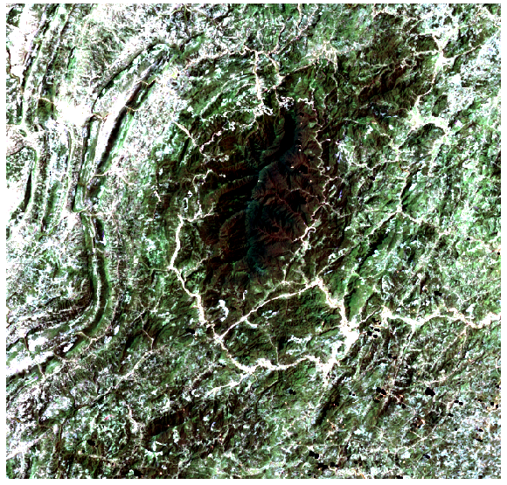
Landsat 5 Satellite Imagery
Pictured: 2/28/2011, processed
30m resolution
Multi-date comparisons
Use: track
land cover/
vegetation
Source: NASA
Processing Credit: Cindy Tsai, SDSU

Slide 13
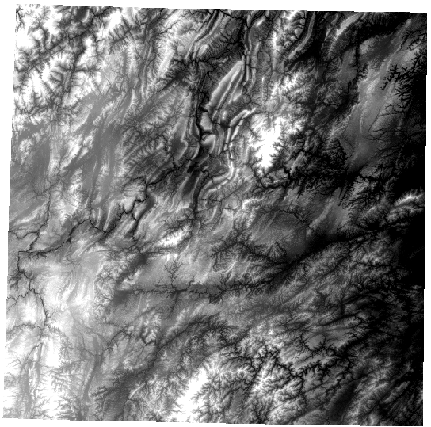
ASTER Digital Elevation Model
2/02/2012
30m resolution
Site: Guizhou Region (covers the FNNR)
Source: NASA
Processing Credit: Cindy Tsai, SDSU

Slide 14
ABM Design & Methodology
Development of model framework
ODD (Overview, Design Concepts, and Details) Protocol for ABMs (Grimm et al. 2006/2010 update)
Logistic regression of variable coefficients
“What if...” situations: if the food availability and other natural variable inputs did not change in a given time step for a given area, but the tourism level does, will the species move, and if so, in what direction?

Slide 15
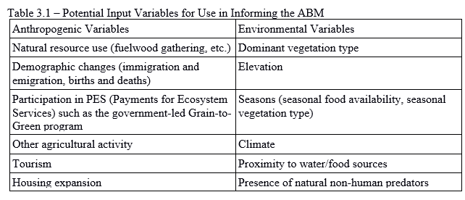
ABM Design & Methodology
Model inputs and outputs
Inputs: both anthropogenic and natural variables
Outputs: visual (and quantitative) movements of agents as measured by distance from households and directionality
Agents: animal species (moving), people (activity buffer)

Slide 16
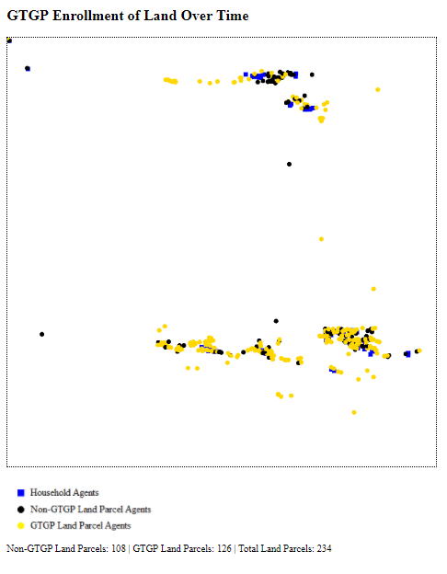
ABM Design & Methodology
Pictured: previous ABM done in FNNR Project by author
(non-movement based,
centered on households)
Why Python vs. Netlogo?
‘Mesa’ Python Library
Moving agents in ABMs:
grid (Sellers et al. 2007) vs. freeform
Depicted: GTGP enrollment status in FNNR residences

Slide 17
ABM Design & Methodology
Output formats:
Results of logistic regression analysis (table)
Visual simulation (and corresponding graphs) that depict the short-range movement of populations of species within the FNNR over seasonal time-steps; several species can be represented in separate runs (interactive webpage launched in a web browser when Python code is run)
Excel file recording model output: distances/directionality traveled per agent, total estimated population changes/shifts in certain buffer areas (.csv/table)
Verification/validation results (table)

Slide 18
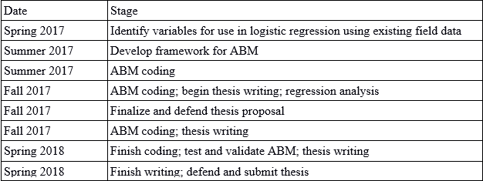
Research Timeline
Final output: a model (simulation) that can characterize the impact of human variables on the movement of animal species

Slide 19
Why This Matters
Improved understanding of how/to what extent human activity affects animal movements, especially of endangered/endemic species within a specific habitat (special attention given to primates)
Further analysis on effectiveness of PES-type programs in conservation efforts
Insight into the application of geospatial ABMs to animal movements

Slide 20
Works Cited
Aitken, Stuart, and Li An. "Figured Worlds: Environmental Complexity and Affective Ecologies in Fanjingshan, China." Ecological Modelling 229 (2012): 5-15. Web.
Aitken, Stuart, Li An, Sarah Wandersee, and Yeqin Yang. "Renegotiating Local Values: The Case of Fanjingshan Reserve, China." Alternative Development: Unravelling Marginalization, Voicing Change. N.p.: Ashgate Group, 2014. N. pag. Print.
Hill, Russell A., Brian S. Logan, William I. Sellers, and Julian Zappala. "An Agent-based Model of Group Decision Making in Baboons." Modelling Natural Action Selection (n.d.): 454-76. Web.
Robbins, Martha M., and Andrew M. Robbins. "Simulation of the Population Dynamics and Social Structure of the Virunga Mountain Gorillas." American Journal of Primatology 63.4 (2004): 201-23. Web.
Tsai, Yu Hsin, Douglas Stow, Lei Shi, Rebecca Lewison, and Li An. "Quantifying Canopy Fractional Cover and Change in Fanjingshan National Nature Reserve, China Using Multi-temporal Landsat Imagery." Remote Sensing Letters 7.7 (2016): 671-80. Web.
Wandersee, Sarah M., Li An, David Lopez-Carr, and Yeqin Yang. "Perception and Decisions in Modeling Coupled Human and Natural Systems: A Case Study from Fanjingshan National Nature Reserve, China." Ecological Modelling 229 (2012): 37-49. Web.
Wu, Gang, Hong-Chang Wang, Hai-Wei Fu, Jing-Zhu Zhao, and Ye-Qin Yang. "Habitat Selection of Guizhou Golden Monkey (Phinopithecus Roxellanae Brelichi) in Fanjing Mountain Biosphere Reserve, China." Journal of Forestry Research 15.3 (2004): 197-202. Web.
Xiang, Zuo-Fu, Yang Yu, Mei Yang, Jingyuan Yang, Mingyao Niao, and Ming Li. "Does Flagship Species Tourism Benefit Conservation? A Case Study of the Golden Snub-nosed Monkey in Shennongjia National Nature Reserve." Chinese Science Bulletin 56.24 (2011): 2553-558. Web.

